Slide 1

CHAPTER -5
CONTINUITY
AND DIFFERENTIABILITY
MODULE : 1/4 e-content

Slide 2
PREVIOUS KNOWLEDGE
Graph of various functions
Concept of limit
Evaluation of limit of certain functions
Definition of derivative and differentiation of certain functions
Product rule and Quotient rule of differentiation

Slide 3
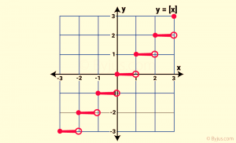
Consider the function f(x) = [ x] . Let us find the limiting value of f(x) when x approaches to 2.
x→2 from both sides of 2
Fig -1

Slide 4
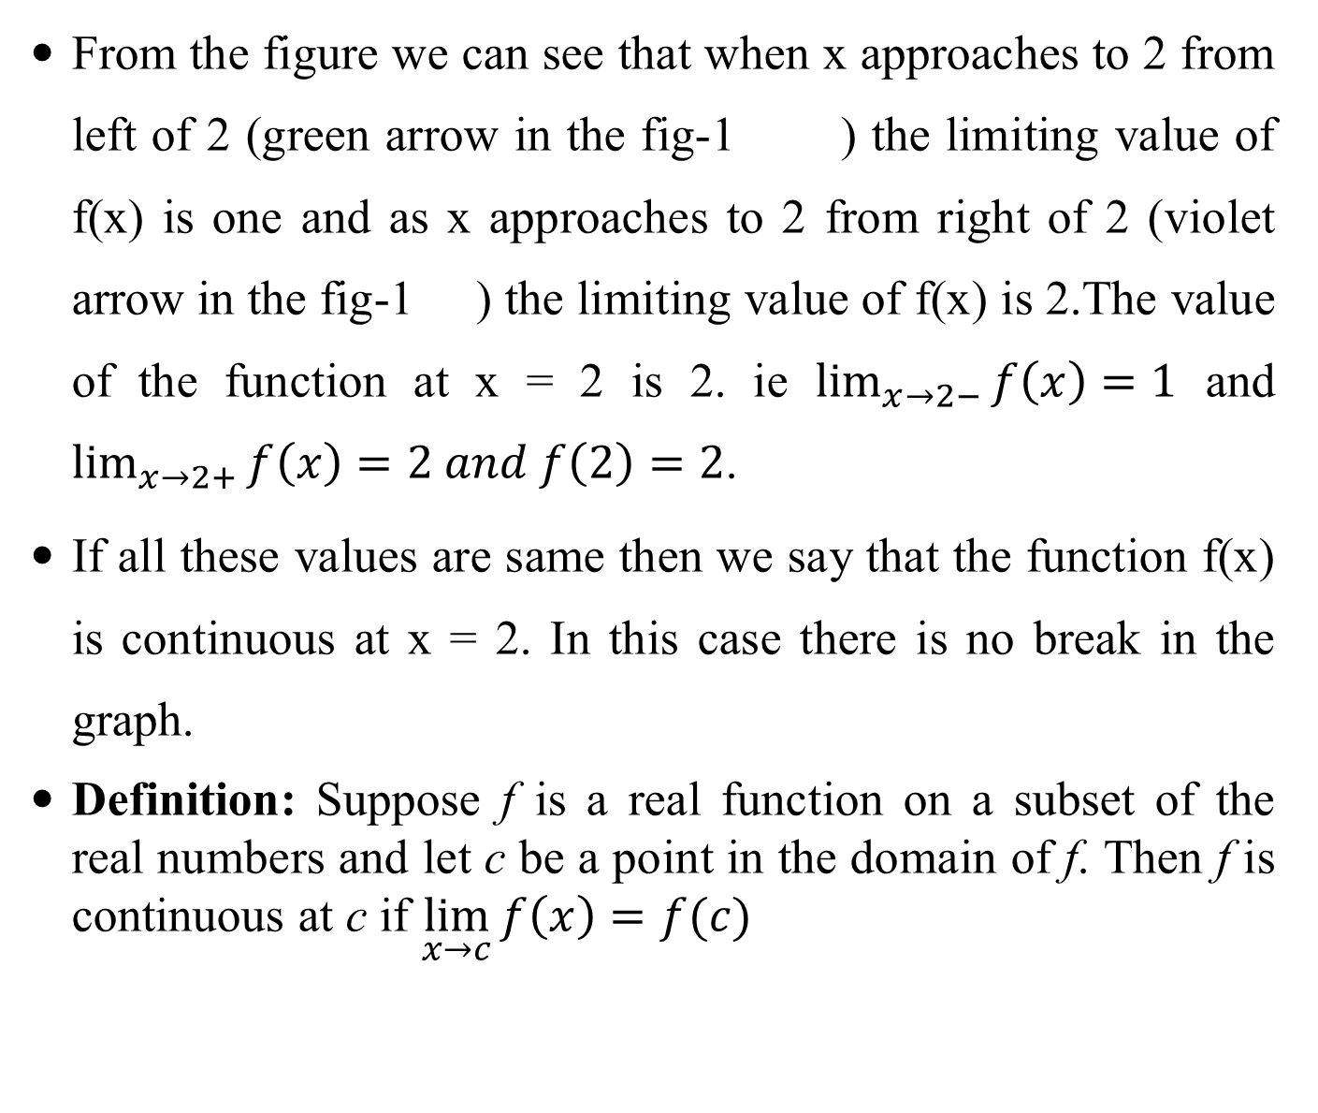
From the figure we can see that when x approaches to 2 from left of 2 (green arrow in the fig-1 ) the limiting value of f(x) is one and as x approaches to 2 from right of 2 (violet arrow in the fig-1 ) the limiting value of f(x) is 2.The value of the function at x = 2 is 2. ie $\lim_{x→2−}{f\left(x\right)=1}$ and $\lim_{x→2+}{f\left(x\right)=2 and f\left(2\right)=2}$.
If all these values are same then we say that the function f(x) is continuous at x = 2. In this case there is no break in the graph.
Definition: Suppose f is a real function on a subset of the real numbers and let c be a point in the domain of f. Then f is continuous at c if $\lim_{x→c}{f\left(x\right)=f(c)}$

Slide 5
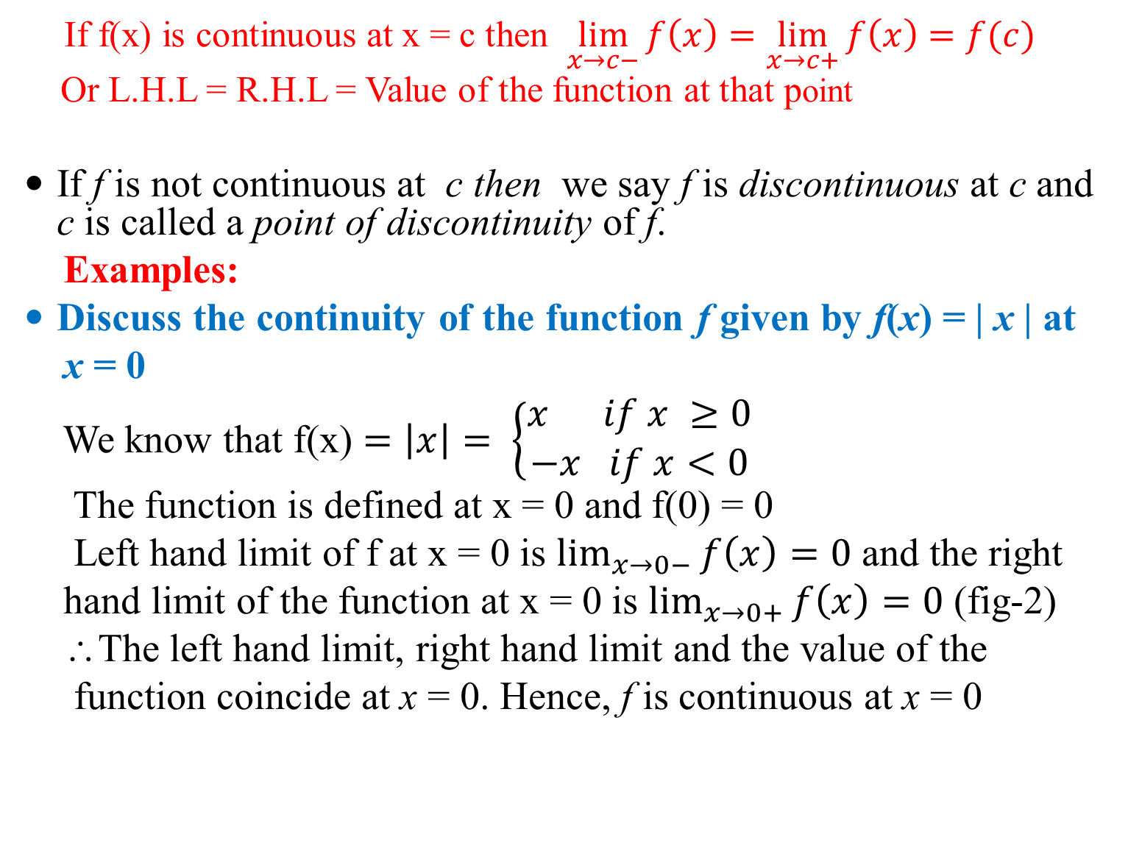
If f(x) is continuous at x = c then $\lim_{x→c−}{f\left(x\right)=\lim_{x→c+}{f\left(x\right)=f(c)} }$
Or L.H.L = R.H.L = Value of the function at that point
If f is not continuous at c then we say f is discontinuous at c and c is called a point of discontinuity of f.
Examples:
Discuss the continuity of the function f given by f(x) = | x | at
x = 0
We know that f(x) $=\left|x\right|= \left\{\begin{aligned}x if x ≥0 \\ −x if x<0\end{aligned}\right.$
The function is defined at x = 0 and f(0) = 0
Left hand limit of f at x = 0 is $\lim_{x→0−}{f\left(x\right)=0}$ and the right
hand limit of the function at x = 0 is $\lim_{x→0+}{f\left(x\right)=0}$ (fig-2)
∴The left hand limit, right hand limit and the value of the
function coincide at x = 0. Hence, f is continuous at x = 0

Slide 6
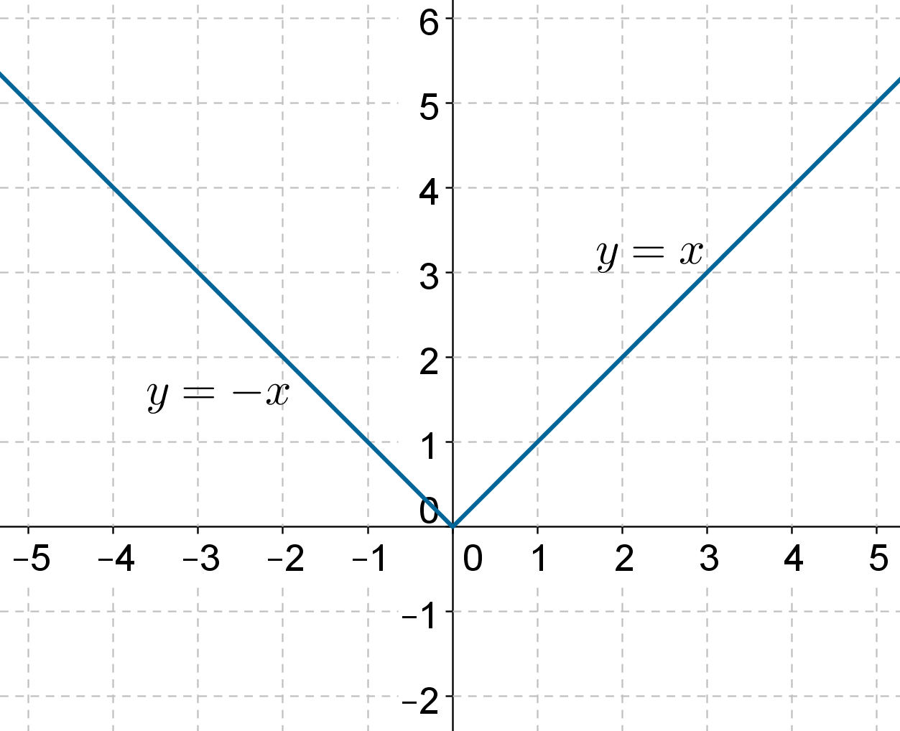
Note : There is no break in the graph
x→ 0 from both sides
Fig-2
A real function f is said to be continuous if it is continuous at every point in the domain of f

Slide 7
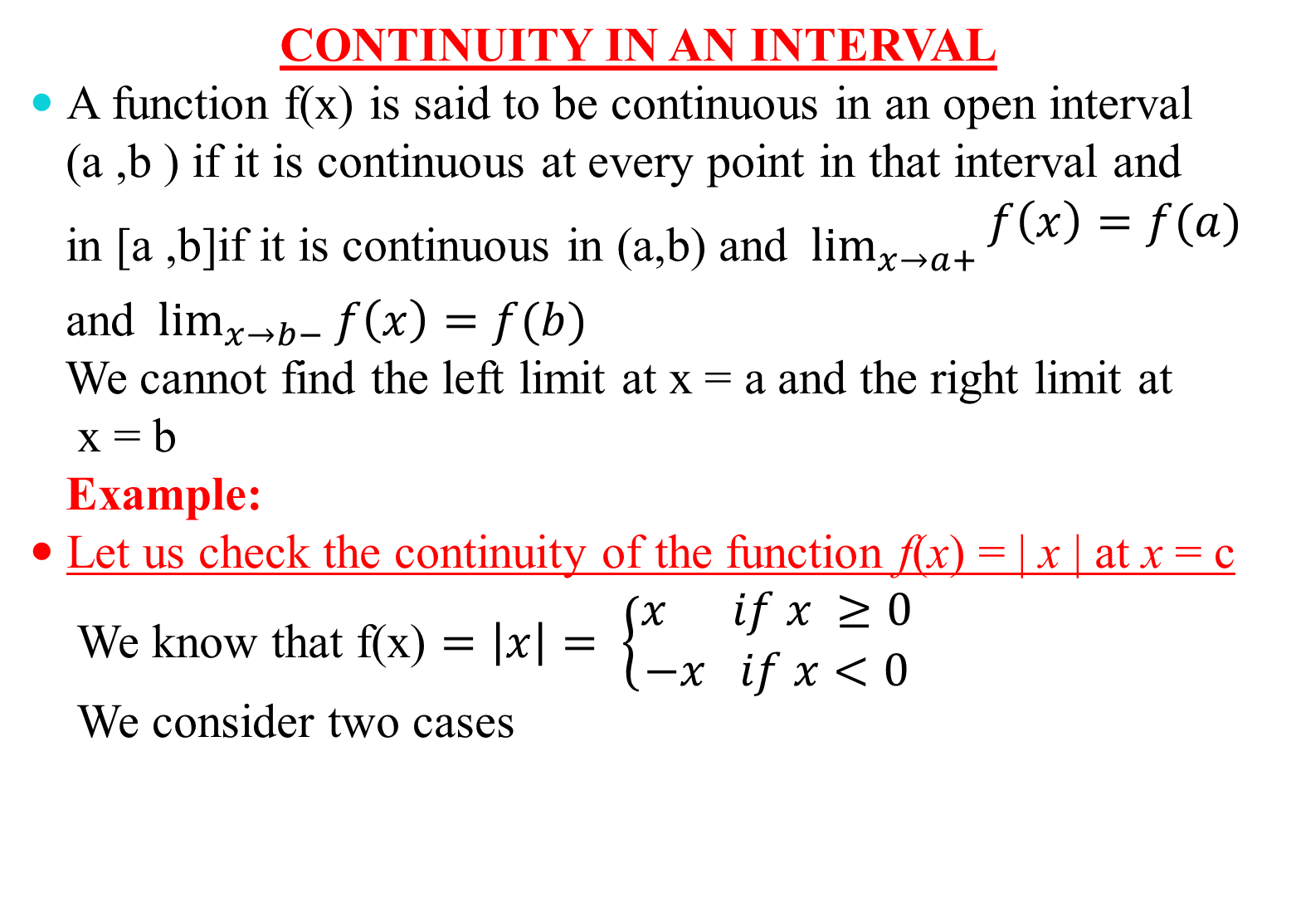
CONTINUITY IN AN INTERVAL
A function f(x) is said to be continuous in an open interval
(a ,b ) if it is continuous at every point in that interval and
in [a ,b]if it is continuous in (a,b) and $\lim_{x→a+}{\begin{aligned}f\left(x\right)=f(a) \\ \end{aligned}}$
and $\lim_{x→b−}{f\left(x\right)=f(b)}$
We cannot find the left limit at x = a and the right limit at
x = b
Example:
Let us check the continuity of the function f(x) = | x | at x = c
We know that f(x) $=\left|x\right|= \left\{\begin{aligned}x if x ≥0 \\ −x if x<0\end{aligned}\right.$
We consider two cases

Slide 8
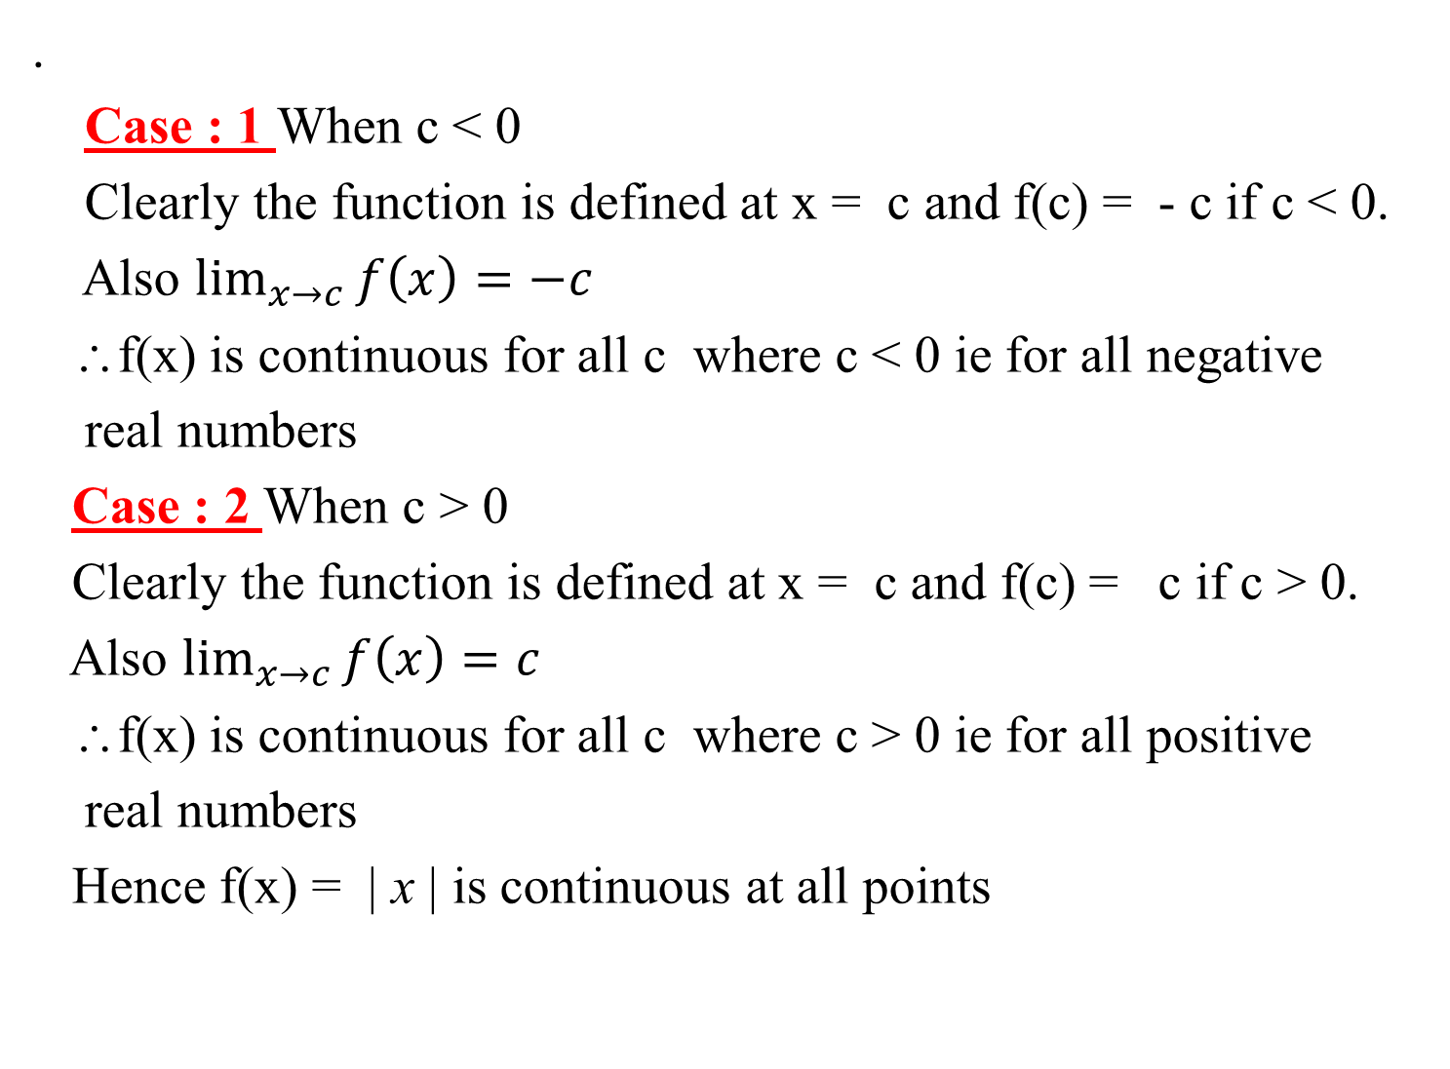
.
Case : 1 When c < 0
Clearly the function is defined at x = c and f(c) = - c if c < 0.
Also $\lim_{x→c}{f\left(x\right)=−c}$
∴f(x) is continuous for all c where c < 0 ie for all negative
real numbers
Case : 2 When c > 0
Clearly the function is defined at x = c and f(c) = c if c > 0.
Also $\lim_{x→c}{f\left(x\right)=c}$
∴f(x) is continuous for all c where c > 0 ie for all positive
real numbers
Hence f(x) = | x | is continuous at all points

Slide 9
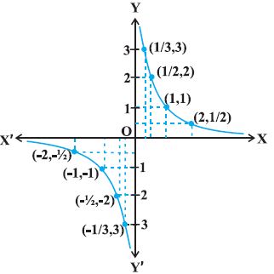

Example:
Consider the function f(x) = $\frac{1}{x}$ , x ≠ 0
For any non zero real number c, f(c) = $\frac{1}{c}$ and $\lim_{x→c}{f\left(x\right)=\frac{1}{c}}$
Hence the function is continuous at all non zero real numbers.
Let us check the limit of this function as x →0
Fig-3

Slide 10
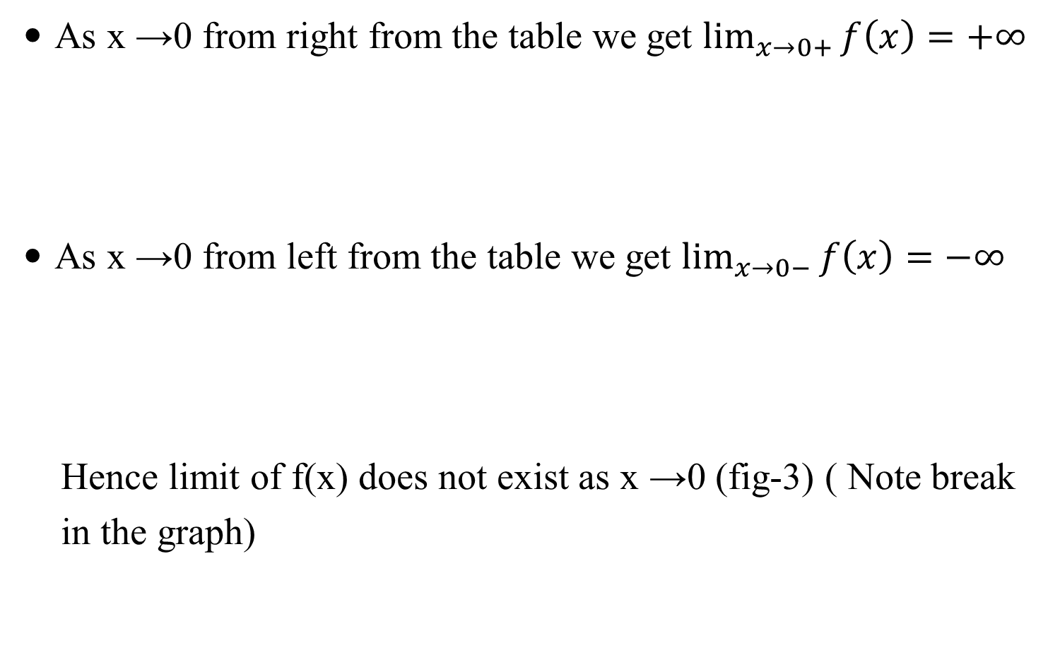
As x →0 from right from the table we get $\lim_{x→0+}{f\left(x\right)=+∞}$
As x →0 from left from the table we get $\lim_{x→0−}{f\left(x\right)=−∞}$
Hence limit of f(x) does not exist as x →0 (fig-3) ( Note break
in the graph)

Slide 11
Examples of some functions which are continuous
Every polynomial function is continuous
All trigonometric functions are continuous in their domain
Greatest integer function is continuous at all non integral points but discontinuous at every integral point
Constant function is continuous
Identity function is continuous
Every rational function is continuous at all point were the function is defined

Slide 12
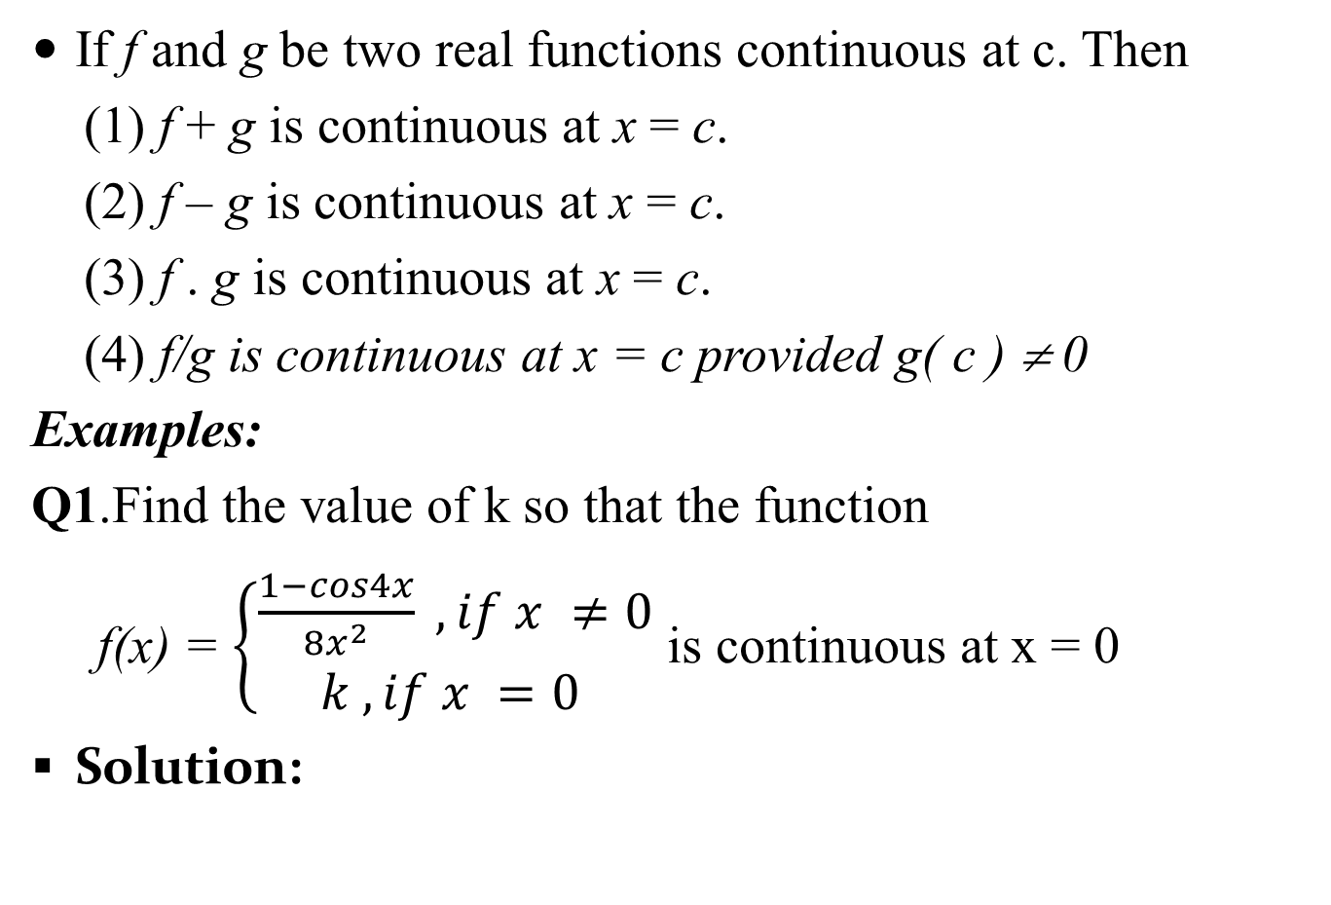
Algebra of continuous functions
If f and g be two real functions continuous at c. Then
(1) f + g is continuous at x = c.
(2) f – g is continuous at x = c.
(3) f . g is continuous at x = c.
(4) f/g is continuous at x = c provided g( c ) ≠ 0
Examples:
Q1.Find the value of k so that the function
f(x) = $\left\{\begin{aligned}\frac{1−cos4x}{8x^{2}} , if x ≠0 \\ k , if x =0 \end{aligned}\right.$ is continuous at x = 0
Solution:

Slide 13

Given
f(x) = $\left\{\begin{aligned}\frac{1−cos4x}{8x^{2}} , if x ≠0 \\ k , if x =0 \end{aligned}\right.$
Since f(x) is continuous at x = 0
$\lim_{x→0−}{f\left(x\right)=\lim_{x→0+}{f\left(x\right)=f(0)}}$------(1)
Given f(x) = $\frac{1−cos4x}{8x^{2}},{if x ≠0}$.
$\lim_{x→0−}{f\left(x\right)}$ = $\lim_{x→0−}{\frac{1−cos4x}{8x^{2}}}$ = $\lim_{h→0}{\frac{1−cos⁡(−4h)}{8h^{2}}}$
( put x = 0-h, x = -h, as x →0, h→0 )
$=\lim_{h→0}{\frac{2\sin^{2}2h}{8h^{2}}}$ = $\lim_{h→0}{\frac{\sin^{2}2h}{4h^{2}}=\lim_{h→0}{{\left(\frac{sin2h}{2h}\right)}^{2}=1}}$
Here f(0) = k
From equation (1) , k = 1

Slide 14
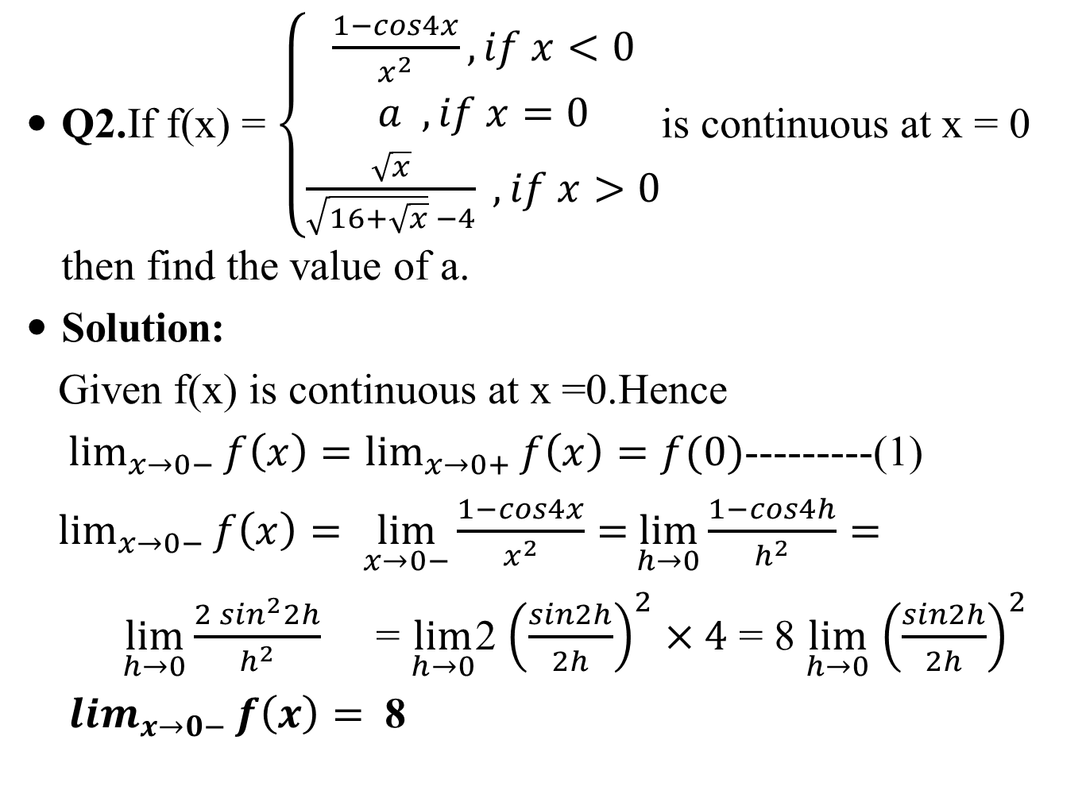
Q2.If f(x) = $\left\{\begin{aligned}\frac{1−cos4x}{x^{2}}, if x<0 \\ a , if x=0 \\ \frac{\sqrt{x}}{\sqrt{16+\sqrt{x}} −4} , if x>0\end{aligned}\right.$is continuous at x = 0 then find the value of a.
Solution:
Given f(x) is continuous at x =0.Hence
$\lim_{x→0−}{f\left(x\right)=\lim_{x→0+}{f\left(x\right)=f(0)}}$---------(1)
$\lim_{x→0−}{f\left(x\right)= \lim_{x→0−}{\frac{1−cos4x}{x^{2}}=}}\lim_{h→0}{\frac{1−cos4h}{h^{2}}=}$
$\lim_{h→0}\frac{{2 sin}^{2}2h}{h^{2}}$ = $\lim_{h→0}$2 ${\left(\frac{sin2h}{2h}\right)}^{2}×4$ = 8 $\lim_{h→0}$ ${\left(\frac{sin2h}{2h}\right)}^{2}$
$\lim_{x→0−}{f\left(x\right)= }$ 8

Slide 15
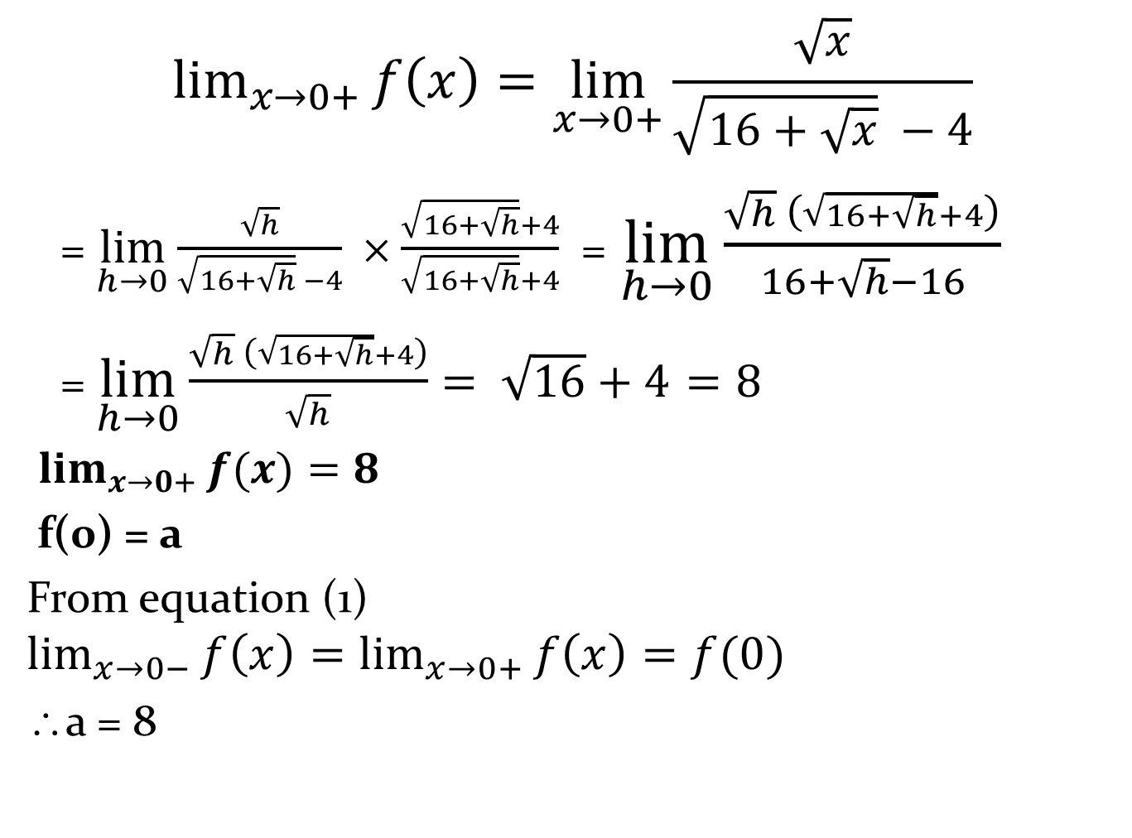
$$\lim_{x→0+}{f\left(x\right)=\lim_{x→0+}{\frac{\sqrt{x}}{\sqrt{16+\sqrt{x}} −4}}}$$
= $\lim_{h→0}{\frac{\sqrt{h}}{\sqrt{16+\sqrt{h}} −4}} ×\frac{\sqrt{16+\sqrt{h}}+4}{\sqrt{16+\sqrt{h}}+4}$ = $\lim_{h→0}{\frac{\sqrt{h} \left(\sqrt{16+\sqrt{h}}+4\right)}{16+\sqrt{h}−16}}$
= $\lim_{h→0}{\frac{\sqrt{h} \left(\sqrt{16+\sqrt{h}}+4\right)}{\sqrt{h}}= \sqrt{16}+4}=8$
$\lim_{x→0+}{f(x)=8}$
f(0) = a
From equation (1) $\lim_{x→0−}{f\left(x\right)=\lim_{x→0+}{f\left(x\right)=f(0)}}$
∴a = 8

Slide 16
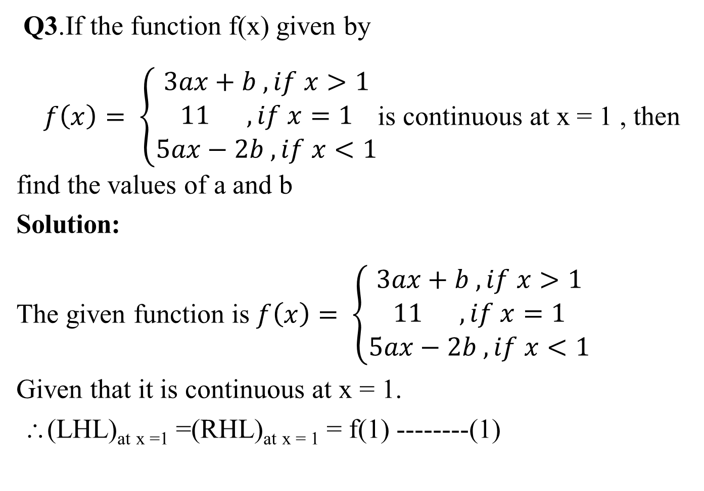
Q3.If the function f(x) given by
$f\left(x\right)= \left\{\begin{aligned}3ax+b , if x>1 \\ 11 , if x=1 \\ 5ax−2b , if x<1\end{aligned}\right.$is continuous at x = 1 , then find the values of a and b
Solution:
The given function is $f\left(x\right)= \left\{\begin{aligned}3ax+b , if x>1 \\ 11 , if x=1 \\ 5ax−2b , if x<1\end{aligned}\right.$
Given that it is continuous at x = 1.
∴(LHL)_{at x =1} =(RHL)_{at x = 1} = f(1) --------(1)

Slide 17
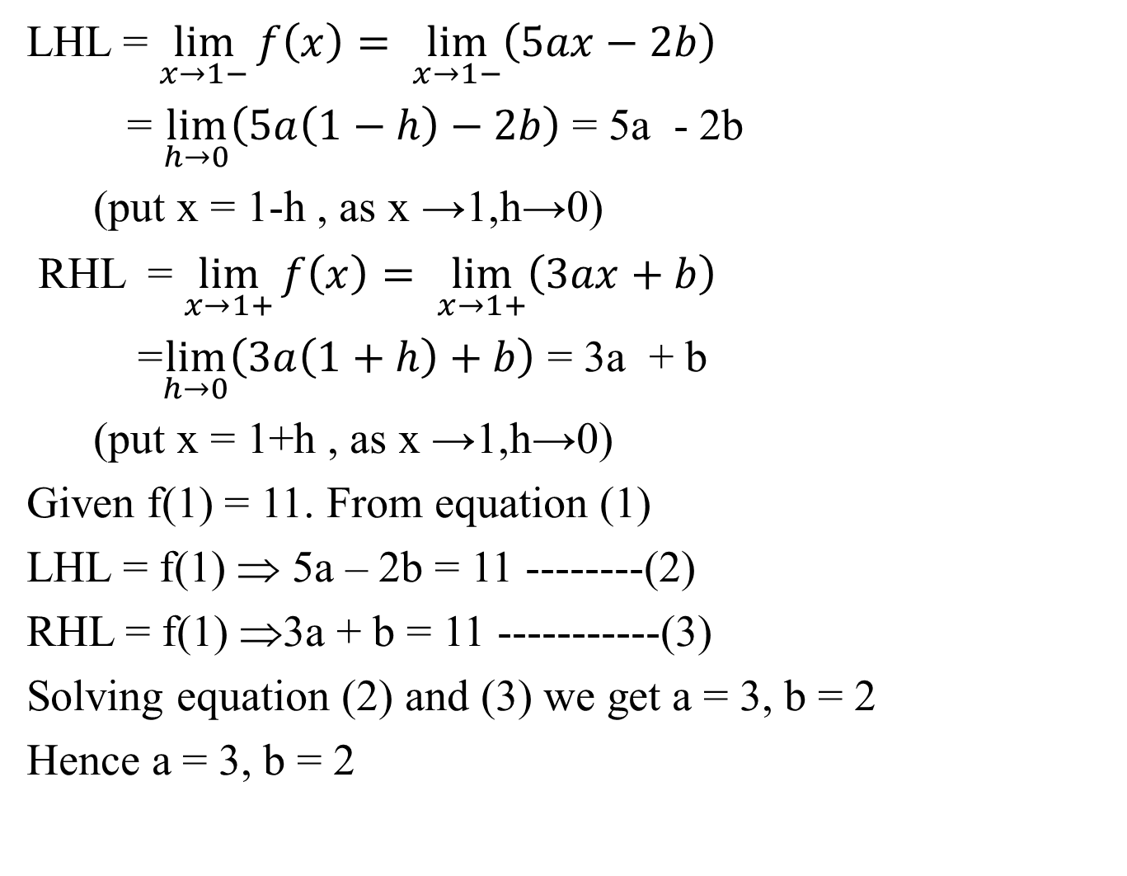
LHL = $\lim_{x→1−}{f\left(x\right)= \lim_{x→1−}\left(5ax−2b\right)}$
= $\lim_{h→0}\left(5a\left(1−h\right)−2b\right)$ = 5a - 2b
(put x = 1-h , as x →1,h→0)
RHL = $\lim_{x→1+}{f\left(x\right)= \lim_{x→1+}\left(3ax+b\right)}$
=$\lim_{h→0}\left(3a\left(1+h\right)+b\right)$ = 3a + b
(put x = 1+h , as x →1,h→0)
Given f(1) = 11. From equation (1)
LHL = f(1) ⇒ 5a – 2b = 11 --------(2)
RHL = f(1) ⇒3a + b = 11 -----------(3)
Solving equation (2) and (3) we get a = 3, b = 2
Hence a = 3, b = 2

Slide 18
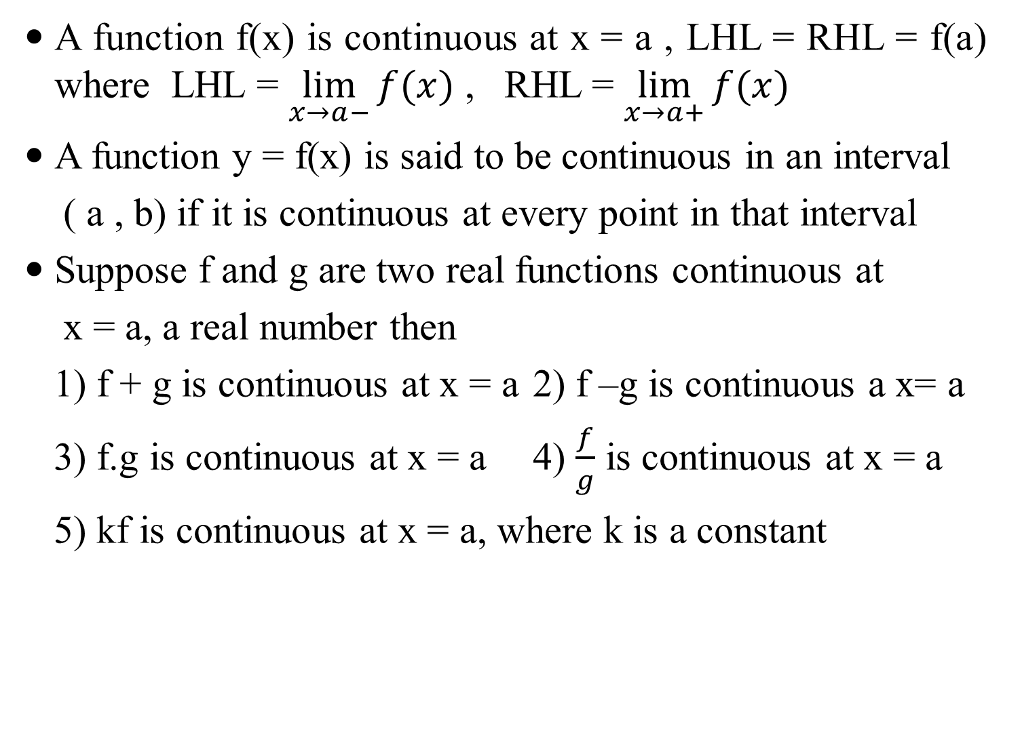
SUMMARY
A function f(x) is continuous at x = a , LHL = RHL = f(a) where LHL = $\lim_{x→a−}{f(x)}$ , RHL = $\lim_{x→a+}{f(x)}$
A function y = f(x) is said to be continuous in an interval
( a , b) if it is continuous at every point in that interval
Suppose f and g are two real functions continuous at
x = a, a real number then
1) f + g is continuous at x = a 2) f –g is continuous a x= a
3) f.g is continuous at x = a 4) $\frac{f}{g}$ is continuous at x = a
5) kf is continuous at x = a, where k is a constant

Slide 19
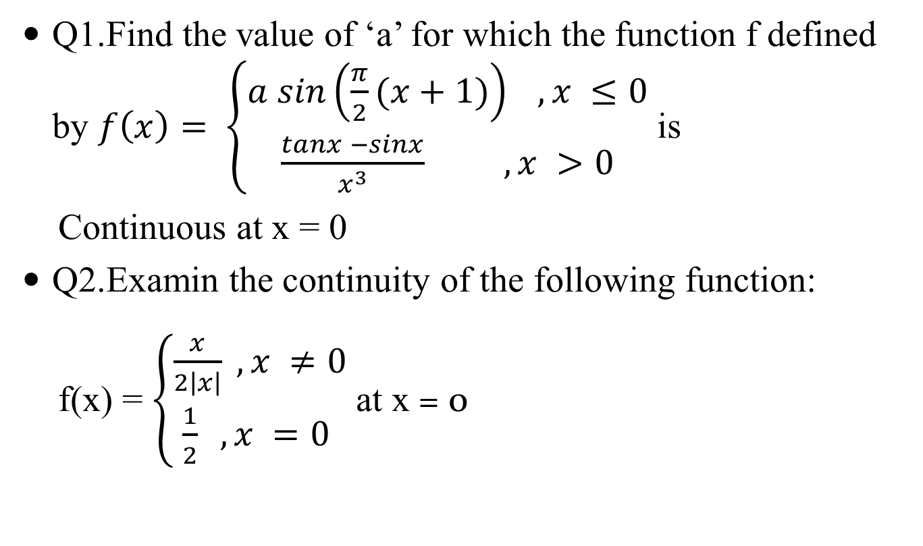
QUESTIONS FOR PRACTICE
Q1.Find the value of ‘a’ for which the function f defined by $f\left(x\right)= \left\{\begin{aligned}a sin\left(\frac{π}{2}(x+1)\right) , x ≤0 \\ \frac{tanx −sinx}{x^{3}} , x >0\end{aligned}\right.$ is
Continuous at x = 0
Q2.Examin the continuity of the following function:
f(x) = $\left\{\begin{aligned}\frac{x}{2\left|x\right|} , x ≠0 \\ \frac{1}{2} , x =0 \end{aligned}\right.$ at x = 0

